Slide 1
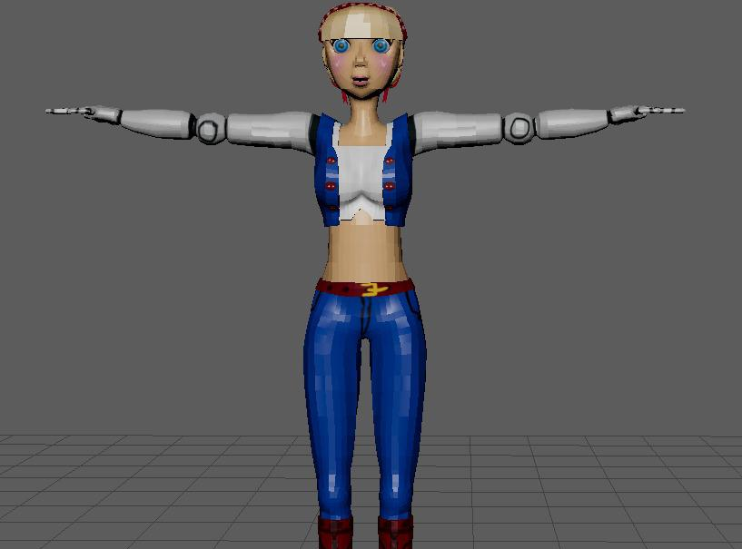
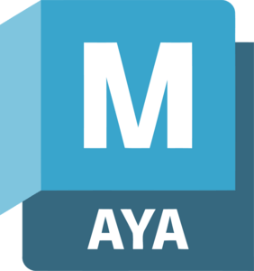
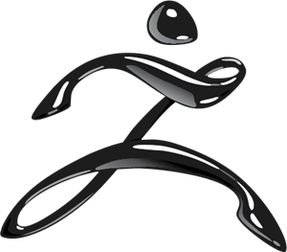
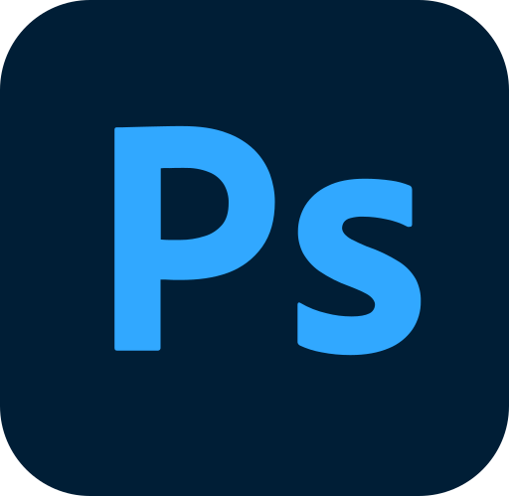
My Violet character
Made by Alaa mamdouh

Slide 2
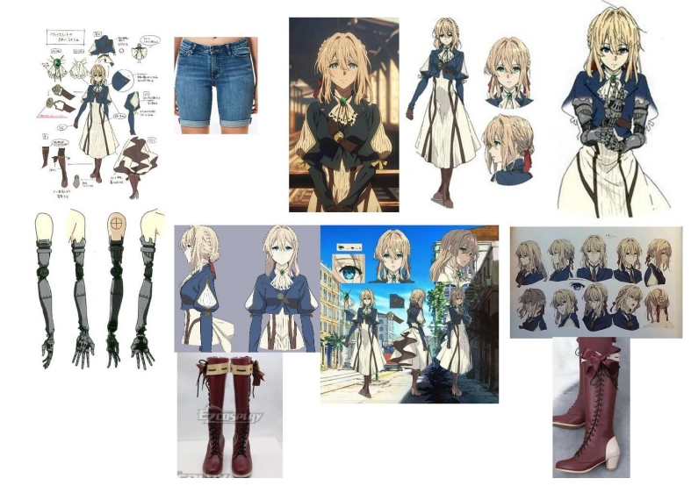
Reference sheet

Slide 3
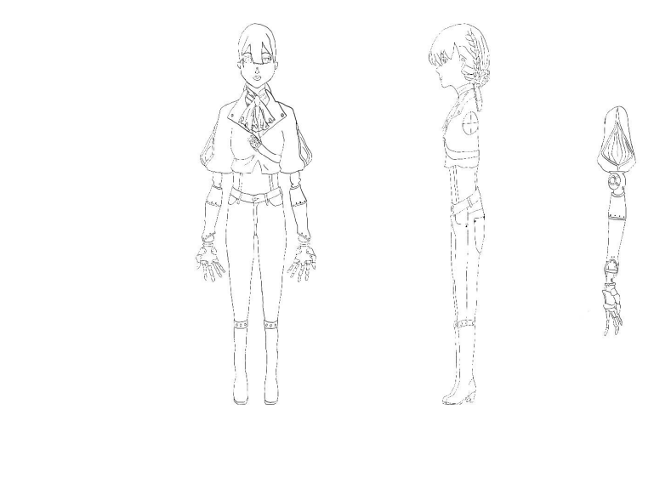
Model sheet

Slide 4
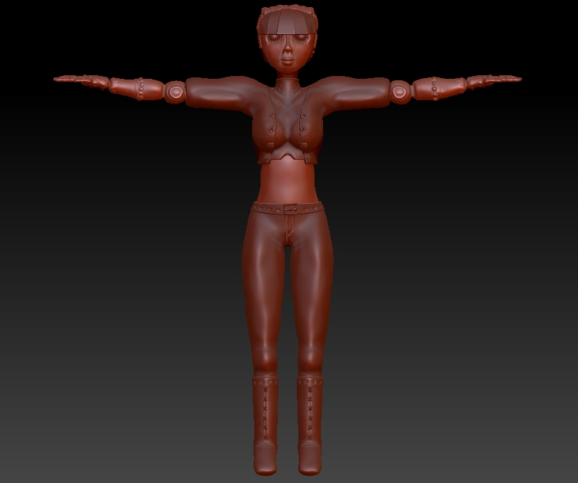
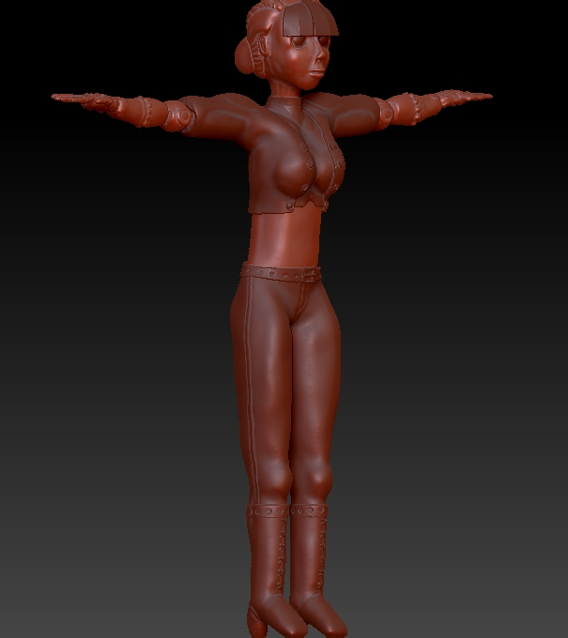
Sculpting phase

Slide 5

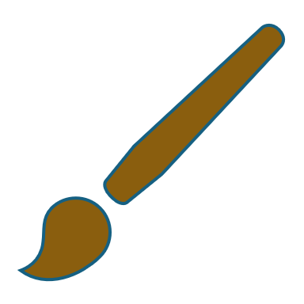
Project details
my 3D project , I've been working on the character Violet.
Software Used:
Photoshop: Character design and texture creation
ZBrush: Sculpting
Maya: Retopology, UV unwrapping, rigging, and animation

Slide 6
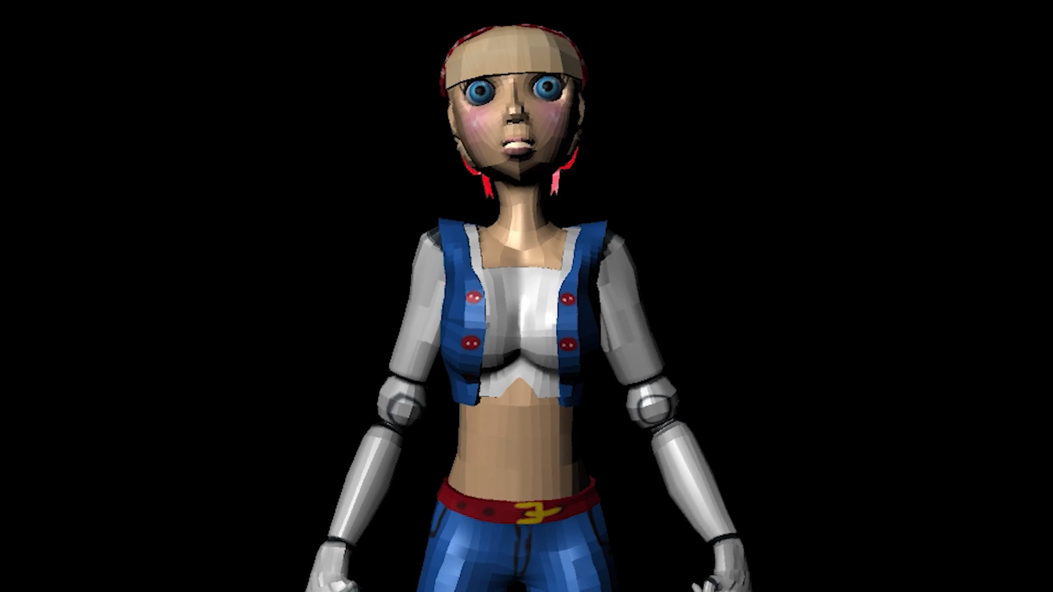
Video

Slide 7
Thank you for your attention

